Slide 1
Research Question
An overview of the research landscape on gender equality and the emerging trends, key contributors, and knowledge gaps in the field.
Who are the key contributors?
How has the research landscape on gender equality evolved over the past decade?
What are the emerging trends?
How can bibliometric analysis help reveal these insights?
What are the knowledge gaps in the field?

Slide 2
Methodology
Data Source
To address these research objectives, a comprehensive bibliometric analysis will be conducted. This analysis will involve the collection and examination of a large dataset of academic publications related to gender equality. Various bibliometric tools and techniques, such as co-citation analysis, keyword analysis, and network analysis, will be applied to extract meaningful insights from the data.
Scopus
Google Scholar
Sci-hub

Slide 3
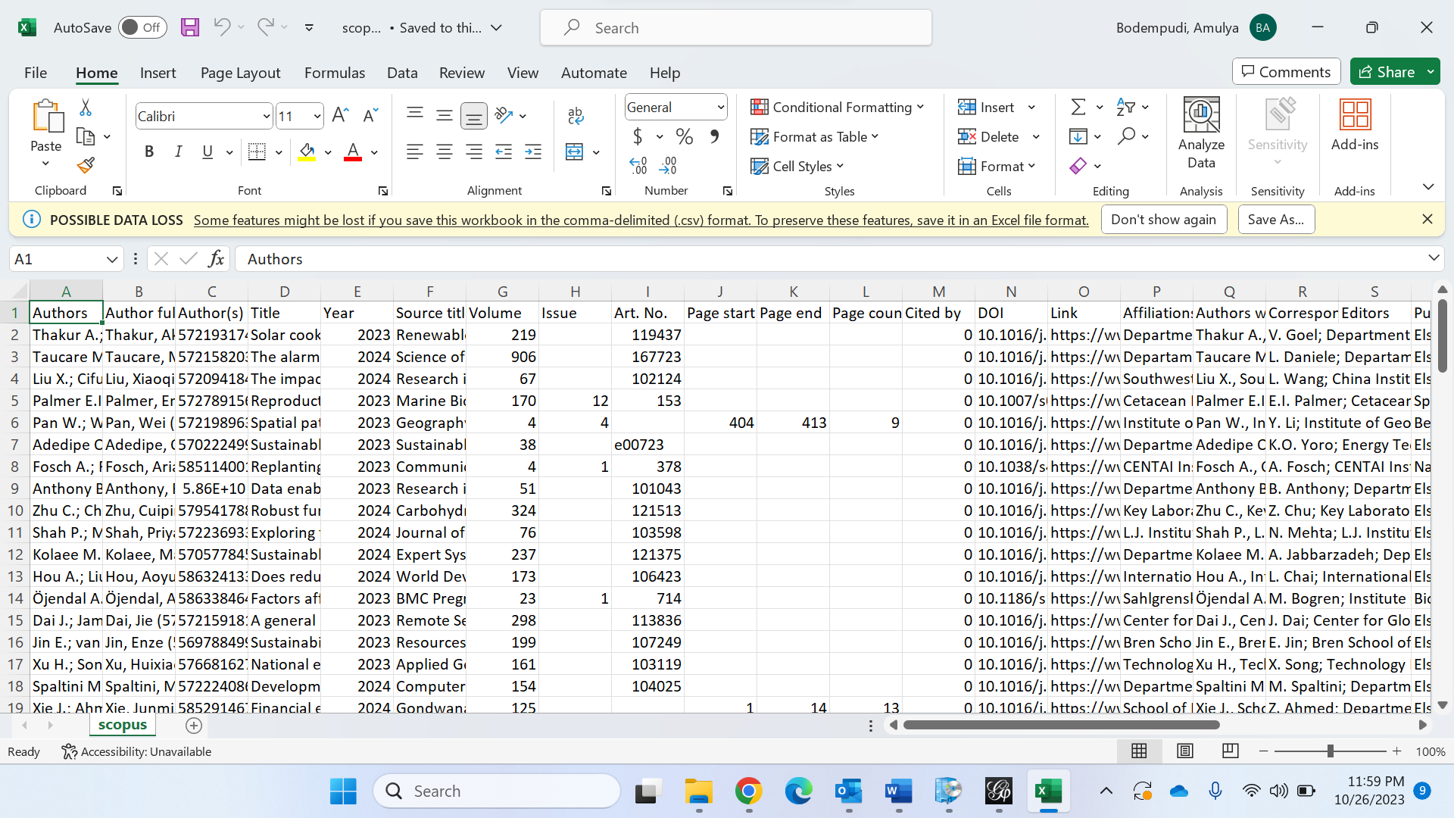
Homework 2

Slide 4
Networks over time
Gephi is at the forefront of graph analysis innovation. Users can manipulate the embedded timeline to see how a network changes over time.
Bring in a temporal graph in GEXF format.
Run measurements (clustering coefficient) across time.
Ready for graph streaming

Slide 5
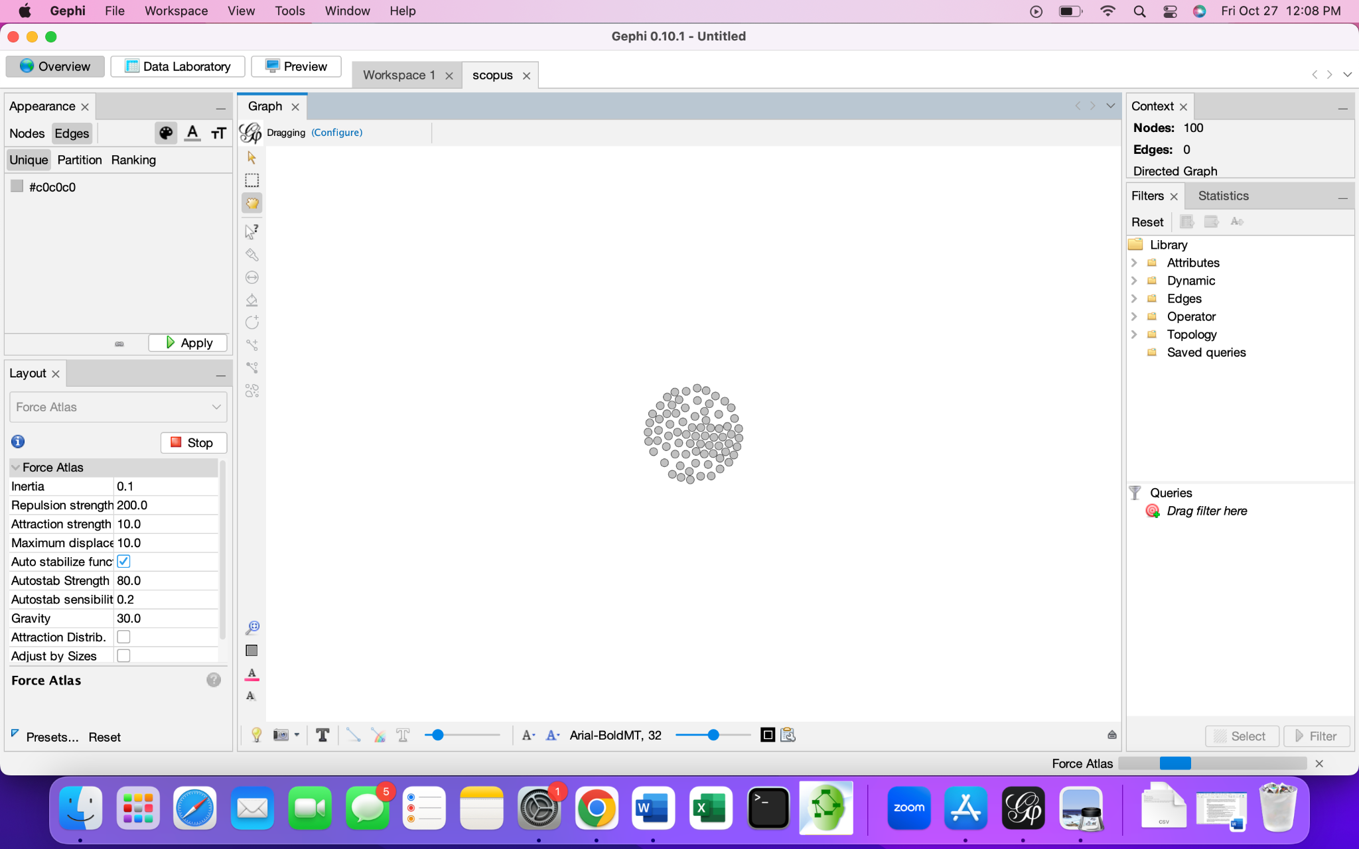
Visualization

Slide 6
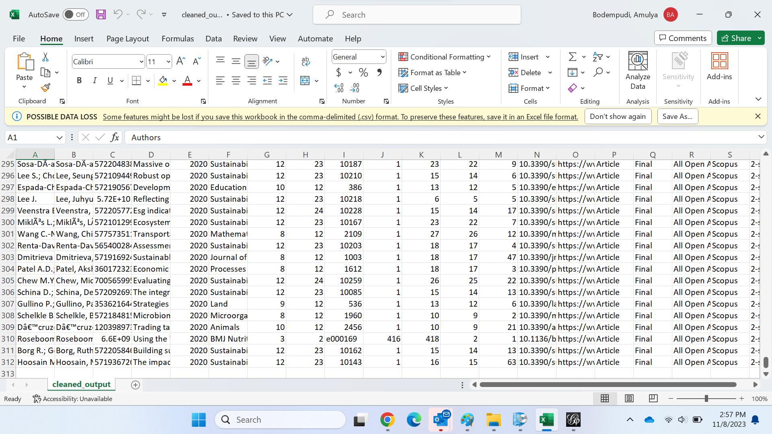
Project Meeting 3

Slide 7
